Slide 1
Sen-220 software engineering
Software Requirements Specification (SRS)

Slide 2
What Is a Software Requirements Specification (SRS) Document?
A software requirements specification (SRS) is a document that describes what the software will do and how it will be expected to perform. It also describes the functionality the product needs to fulfill all stakeholders (business, users) needs.

Slide 3
What Is a Software Requirements Specification (SRS) Document?
An SRS can be simply summarized into four Ds:
Define your product's purpose.
Describe what you're building.
Detail the requirements.
Deliver it for approval.

Slide 4
Why Use an SRS Document?
An SRS gives you a complete picture of your entire project. It provides a single source of truth that every team involved in development will follow. It is your plan of action and keeps all your teams — from development to maintenance — on the same page.

Slide 5
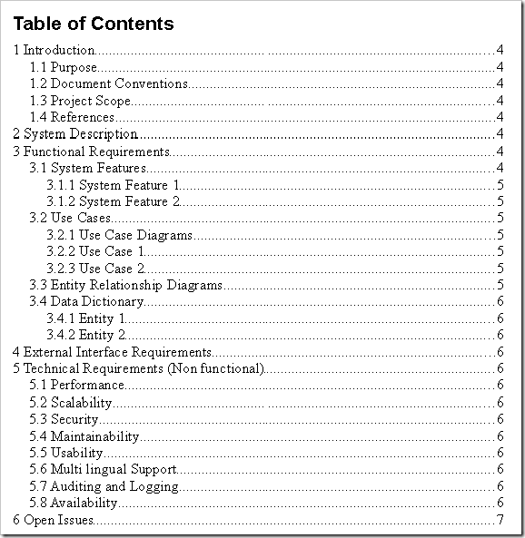
How to Write an SRS Document?
Table of Contents
1. Introduction
An introduction is a beginning section which states the purpose and goals of the following writing.
1.1. Purpose
Write about what is the purpose of making this this project.
- Example: The purpose of this document is to build an online system to manage flights and passengers to ease the flight management.

Slide 6
How to Write an SRS Document?
1.2. Intended Audience and Intended Use
- Define who in your organization will have access to the SRS and how they should use it. This may include developers, testers, and project managers. It could also include stakeholders in other departments, including leadership teams, sales, and marketing.
Example: Intended Audience: This app is made for kids and individuals who have different ways of learning or special needs. It's designed to help those who might find traditional learning a bit hard or need extra support while learning new things.
Intended Use: This app is meant to be used as a fun and helpful tool for learning. It has games, activities, and lessons tailored to suit various learning styles and needs. It's here to make learning more enjoyable and easier for everyone who uses it, providing a way to learn at your own pace and in a way that works best for you.
1.3. Scope
- What are the benefits, objectives, and goals we intend to have for this product? This should relate to overall business goals, especially if teams outside of development will have access to the SRS.
- Example: The purpose of the online flight management system is to ease flight management and to create a convenient and easy-to-use application for passengers, trying to buy airline tickets. The system is based on a relational database with its flight management and reservation functions. We will have a database server supporting hundreds of major cities around the world as well as thousands of flights by various airline companies. Above all, we hope to provide a comfortable user experience along with the best pricing available.

Slide 7
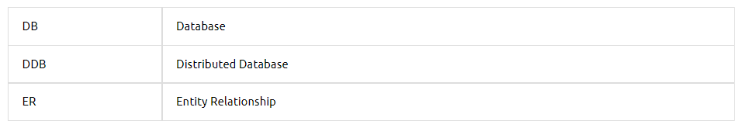
How to Write an SRS Document?
1.4. Document Conventions
You explain the formats used in the document. What are bold words for, what is italic used for and so on.

Slide 8
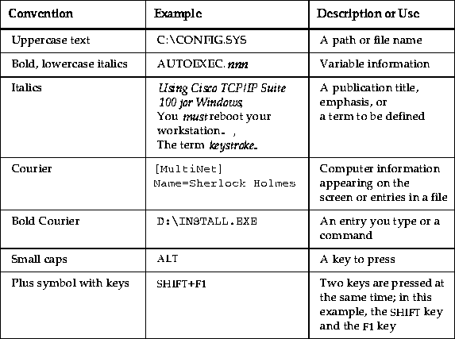
How to Write an SRS Document?

Slide 9
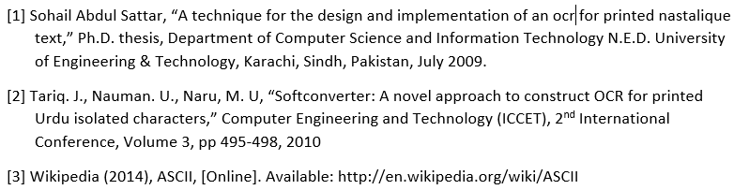
How to Write an SRS Document?
1.5 References:
In your writing, you cite or refer to the source of information. A reference gives the readers details about the source so that they have a good understanding of what kind of source it is and could find the source themselves if necessary.
Example:

Slide 10
How to Write an SRS Document?
2. Overall Description
2.1.Use Case Diagram
2.2.Activity Diagram
3- System Features and Requirements
3.1.Functional Requirements
3.2.Non-Functional Requirements
3.3.System Interfaces
4. Risk Table

Slide 11
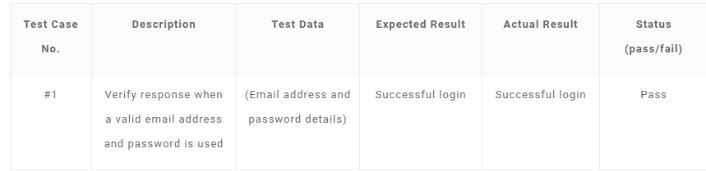
How to Write an SRS Document?
5.Test Cases
5.1.Test Case 1
5.2.Test Case 2
5.3.Test Case 3
5.4.Test Case 4
5.5.Test Case 5

Slide 12
Examples of SRS Documents
https://www.slideshare.net/Axphey/the-complete-srs-documentation-of-our-developed-game

